Slide 1

Introduction to Cython
Date: 2022/11/18
Speaker: 化學四 B08203047 沈智恩

Slide 2
Outline
Introduction
Implementation
My research
Summary

Slide 3
Introduction

Slide 4

Why Is Python So Slow?
Python is a high-level language
Compare with other languages, python is very slow
Interpreted language
Just-in-time compilation
Global interpreter lock (GIL)

Slide 5


Why We Need Cython?
Cython: C-extension of python
Cython can accelerate your python code
Compare with C/C++, writing cython code is much easier
My comments: numpy and scipy library can still be used in cython!

Slide 6
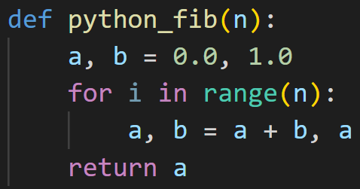
Fibonacci Sequence in Python
Simple python code

Slide 7
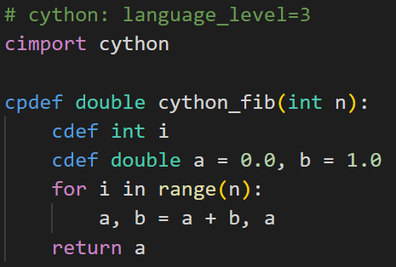
Fibonacci Sequence in Cython
cfib.pyx
setup.py
fib.py
Difference
Variables and function declaration (cdef, cpdef)
Defining variable and function type is important!
Language level: python 3 or python 2

Slide 8
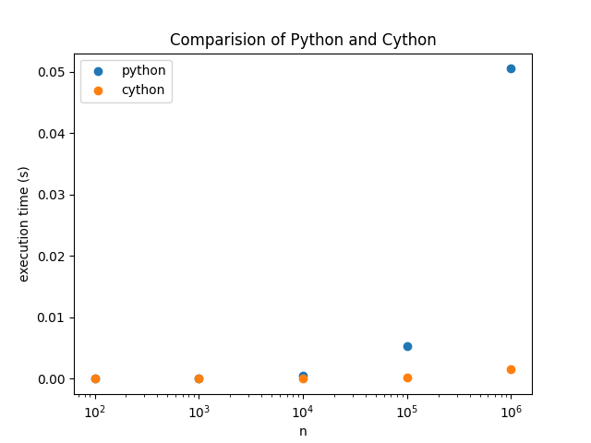
Comparison of Python and Cython

Slide 9
Comparison of Python and Cython
n | Python running time (s) | Cython running time (s)
1e2 | 7.41e-06 | 2.31e-06
1e3 | 5.77e-05 | 3.21e-06
1e4 | 5.59e-04 | 3.07e-05
1e5 | 5.35e-03 | 1.67e-04
1e6 | 5.05e-02 | 1.57e-03

Slide 10
Implementation

Slide 11
How to Run Cython?
In Windows, you need to install Visual Studio
Github: https://github.com/Ch-EnShen/cp_mid
Installation
Write cython code and save it as .pyx
Create setup.py
Build
pip install Cython
Prepare 3 files:
cython.pyx
setup.py
main.py
python setup.py build_ext --inplace

Slide 12
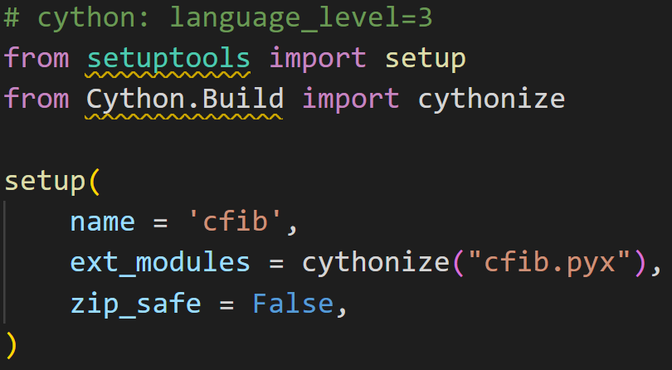
Setup.py
cfib.pyx
setup.py
fib.py
Define languege_level, and import cython module is needed

Slide 13
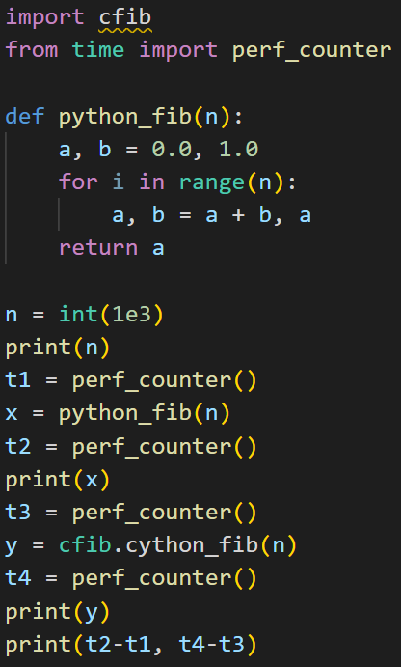
Fib.py
cfib.pyx
setup.py
fib.py

Slide 14
My Research

Slide 15
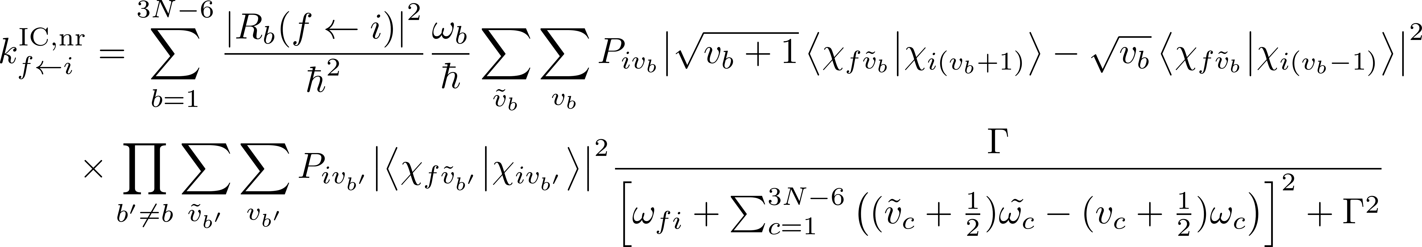
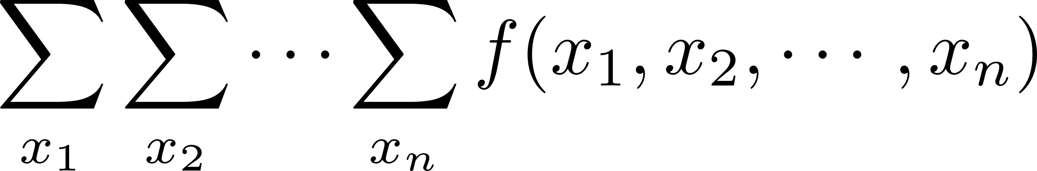


Internal conversion rate
Non-linear molecule with N atoms → 3N-6 vibrational modes → 7N-12 summation
Energy
$$S_{1}$$
From Fermi’s golden rule
$$S_{0}$$
Internal coordinate

Slide 16
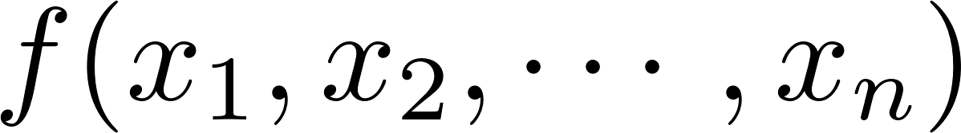
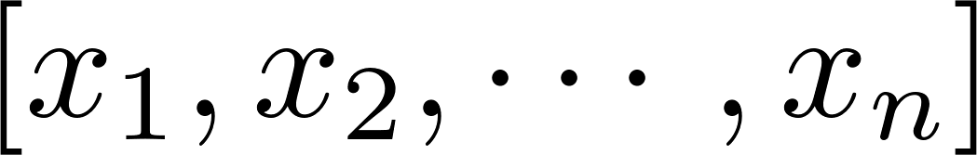
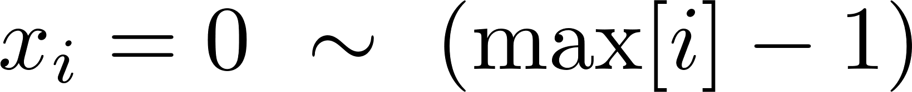
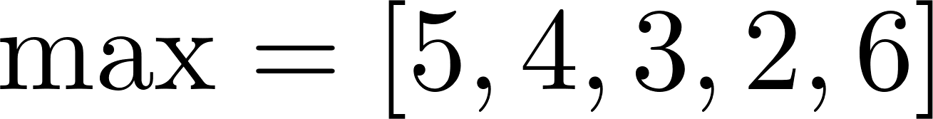
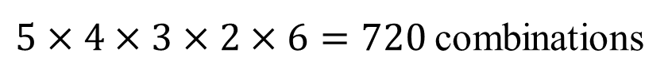
Code Implementation
To implement
Construct the function
Input is an array
Generate for each
E.g.
$5×4×3×2×6=720$combinations
0~4
0~3
0~2
0~1
0~5

Slide 17
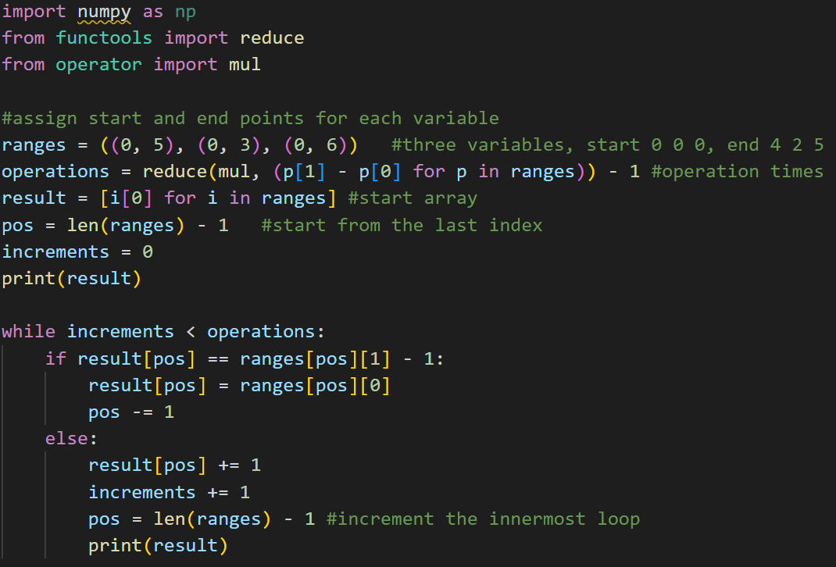
Algorithm
recursion - Function with varying number of For Loops (python) - Stack Overflow
algorithm_generate_array.py
pos

Slide 18
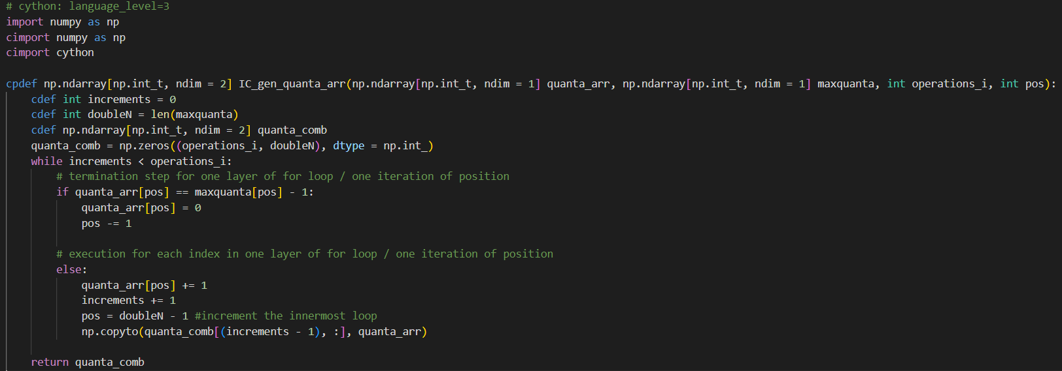
Cython Code
my_research.pyx

Slide 19
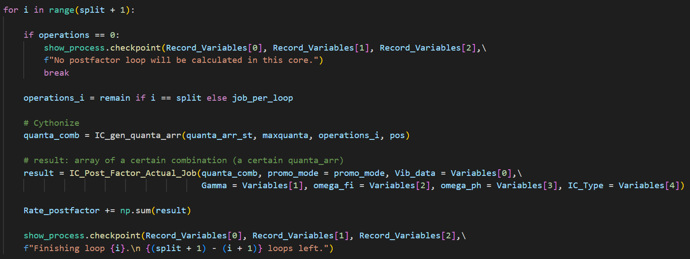
In Python…

Slide 20
Reference
Cython documentation: https://cython.readthedocs.io/en/latest/
https://www.51cto.com/article/711919.html
https://buzzorange.com/techorange/2018/08/14/python-is-slow/
https://jarvus.dragonbeef.net/note/noteCython.php
Cython - A guide for Python programmers (2015) by Kurt W. Smith

